Slide 1
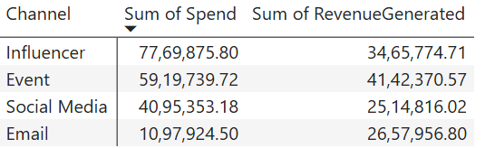
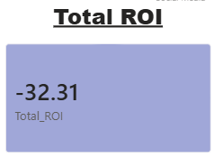
Ad campaigns Analyst at GlowUp

Slide 2
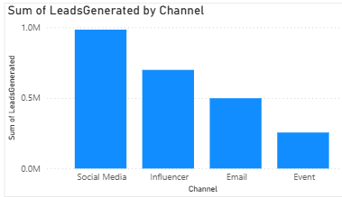
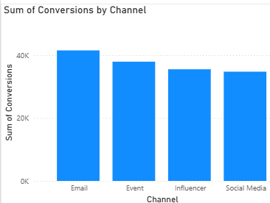
Leads Generated
Conversions

Slide 3
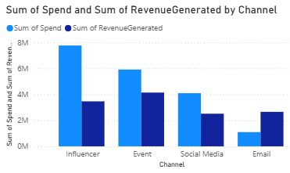
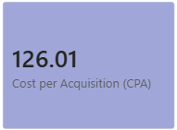
Revenue Generated and Spend
Cost per Acquisition

Slide 4
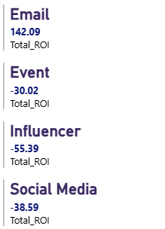
Solution of the business problem
ROI of email is positive, while all roi are negative, and the total spend on the email campaign is the least.
To increase the total ROI, we need to increase the investment in the email campaign and also focus more on email.

Slide 5
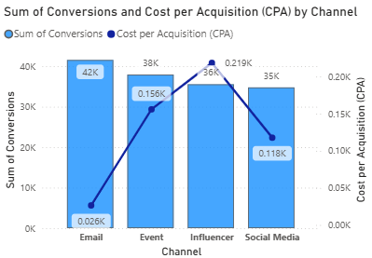
The number of conversions via email is highest and the cost per acquisition for email is very less which is a good sign but for the influencer campaign, CPA is too high company need to reduce the spend on the influencer campaign to gain maximum leads company need to focus more on email and change the strategy for influencer and event campaigns.

Slide 6
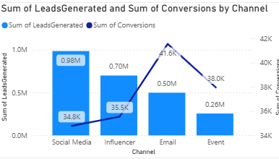
Social media has very high leads, but people don’t buy the product, which decreases the ROI.
TO increase the conversion rate company need to target a specific group of people for the skin care product for girls. We need to target the girls and also target the specific age group people .

Slide 7
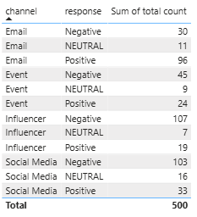
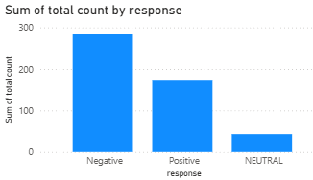
Here in the table, when ROI is between -1.5 and 1.5% taken as neutral less the -1.5% as a negative response and greater then 1.5% taken as a positive.
So campaign like email have maximum positive response, very few negative response on the other hand, influencer and event campaigns have maximum negative responses and fewer positive responses, which concludes that the company need the spend more on email campaigns and change the style of ads in event and influencer campaigns.

